Slide 1
LM05 Protocol
Sumit Kumar(M23IQT007)

Slide 2
Introduction
Quantum key distribution (QKD) allows two parties, traditionally called Alice and Bob, to establish a shared secret key while ensuring security based on the principles of quantum mechanics. The LM05 protocol, proposed by Lucamarini and Mancini in 2005, is a two-way deterministic QKD protocol that does not require entanglement between photons.
Traditional QKD Protocols
Many traditional QKD protocols, such as BB84, rely on one-way communication from Alice to Bob. These protocols often require a basis reconciliation step to ensure that Alice and Bob's bases are aligned, and they are susceptible to inherent errors due to channel noise.

Slide 3
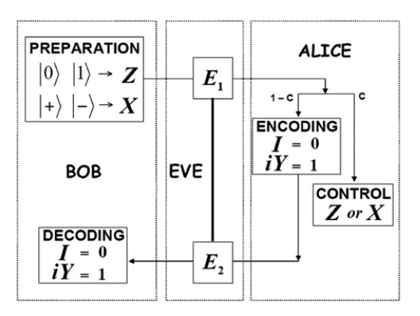
The LM05 Protocol
The LM05 protocol is a two-way protocol, where Alice and Bob exchange single qubits (quantum bits) back and forth. Unlike traditional protocols, it does not require basis reconciliation, as Bob can deterministically infer Alice's message without needing to know her basis.

Slide 4
Protocol Steps
Preparation: Bob prepares a single qubit in one of four possible states: |0⟩, |1⟩, |+⟩, or |-⟩. These states belong to two complementary bases: the Z-basis (|0⟩, |1⟩) and the X-basis (|+⟩, |-⟩).
Transmission: Bob sends the prepared qubit to Alice through a quantum channel.
Encoding: Upon receiving the qubit, Alice encodes her secret bit (either 0 or 1) by applying one of two operators:
If she wants to encode 0, she applies the identity operator (I), leaving the qubit unchanged.
If she wants to encode 1, she applies the Pauli-Y operator (iY), which flips the state of the qubit.
Retransmission: After encoding her bit, Alice sends the qubit back to Bob through the quantum channel.
Measurement and Key Generation: Upon receiving the qubit from Alice, Bob measures it in the same basis he originally prepared it. By comparing the measurement outcome with his initial preparation, Bob can deterministically infer Alice's encoded bit (0 or 1) without the need for basis reconciliation.

Slide 5
Example
Preparation: Bob prepares a qubit in the state |0⟩ (Z-basis).
Transmission: Bob sends the qubit |0⟩ to Alice.
Encoding: Alice wants to encode the bit 1, so she applies the Pauli-Y operator (iY) to the qubit: iY|0⟩ = -|1⟩.
Retransmission: Alice sends the encoded qubit -|1⟩ back to Bob.
Measurement and Key Generation: Bob receives the qubit and measures it in the Z-basis. Measuring -|1⟩ in the Z-basis will yield the outcome |1⟩ with certainty. By comparing the measurement outcome |1⟩ with his initial preparation |0⟩, Bob can infer that Alice encoded the bit 1.

Slide 6
Security Features
The LM05 protocol includes a control mode to detect the presence of an eavesdropper (Eve). In this mode, Alice performs a projective measurement on the qubit she receives from Bob, prepares a new qubit in the same state as the measurement outcome, and sends it back to Bob. By comparing the state Bob receives with the state he initially sent, they can estimate the level of disturbance introduced by a potential eavesdropper.
The security of the LM05 protocol relies on the fact that an eavesdropper cannot simultaneously gain information about the key and remain undetected in the control mode. If Eve attempts to measure the qubits in the wrong basis, she will introduce disturbances that can be detected by Alice and Bob.

Slide 7
Advantages and Disadvantages
Advantages:
No basis reconciliation required, simplifying the protocol.
Deterministic key generation, as Bob can directly infer Alice's bits.
Potential for higher key rates compared to traditional protocols.
Disadvantages:
Requires two-way communication, which can be less efficient than one-way protocols.

Slide 8
Practical Implementations and Applications
Several experimental demonstrations and implementations of the LM05 protocol have been reported in the literature. The protocol has potential applications in secure communication systems, quantum networks, and other areas where quantum key distribution is relevant.

Slide 9
Conclusion
The LM05 protocol is a two-way deterministic QKD protocol that offers an alternative approach to secure key distribution without the need for entanglement or basis reconciliation. While it has several advantages, it is essential to consider potential vulnerabilities and implement appropriate security measures to ensure the confidentiality of the shared key. As with any QKD protocol, the security of the LM05 protocol ultimately relies on the fundamental principles of quantum mechanics, such as the no-cloning theorem and the uncertainty principle.

Slide 10
Reference:-
Can Two-Way Direct Communication Protocols Be Considered Secure?Mladen Pavicic .
Implementation of two way Quantum Key Distribution protocol with decoy state - M.F. Abdul Khir a,c,⁎, M.N. Mohd Zain c, Iskandar Bahari d, Suryadi b, S. Shaari a

